Slide 1


Slide 2

Разработка чатботов на платформе Microsoft Azure и Microsoft Bot Framework
Oleksandr Krakovetskyi
CEO DevRain Solutions, devrain.com
Microsoft Regional Director (Ukraine)
Microsoft Most Valuable Professional
@msugvnua
https://www.facebook.com/alex.krakovetskiy

Slide 3
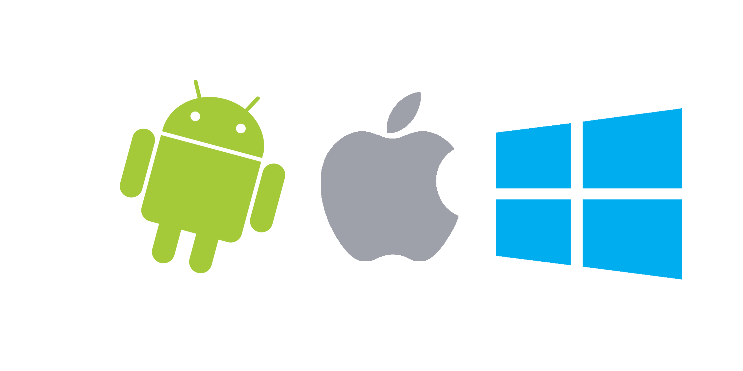
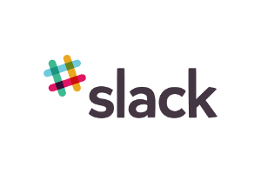





Apps vs. Messengers
3+ million apps in Apple Store and Google Play
Most smartphone users download zero apps per month http://qz.com/253618/most-smartphone-users-download-zero-apps-per-month/
80% of time users spend in 3 apps
Top is a place for “big players”
< 2% in top – new publishers
WhatsApp 1 billion users,
Facebook Messenger – 900 million
WeChat – 700 mln
Messaging apps are now bigger than social networks http://www.businessinsider.com/the-messaging-app-report-2015-11?IR=T

Slide 4
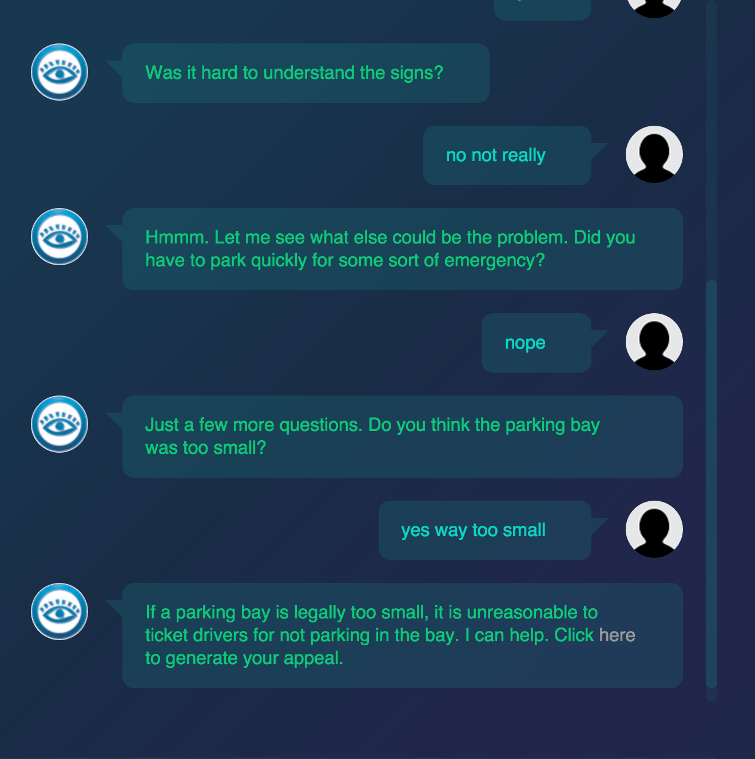
Bots in real life
Microsoft Xiaoice (China), 17-years old girl, lives in WeChat and Weibo. It’s called the largest Turing test in history http://nautil.us/issue/33/attraction/your-next-new-best-friend-might-be-a-robot
X2AI from Silicon Valley created a bot for helping Syrian refugees in Lebanon http://www.techinsider.io/psychotherapy-bot-in-middle-east-2016-3
A 19-year-old made a free robot lawyer that has appealed $3 million in parking tickets http://www.techinsider.io/joshua-browder-bot-for-parking-tickets-2016-2

Slide 5
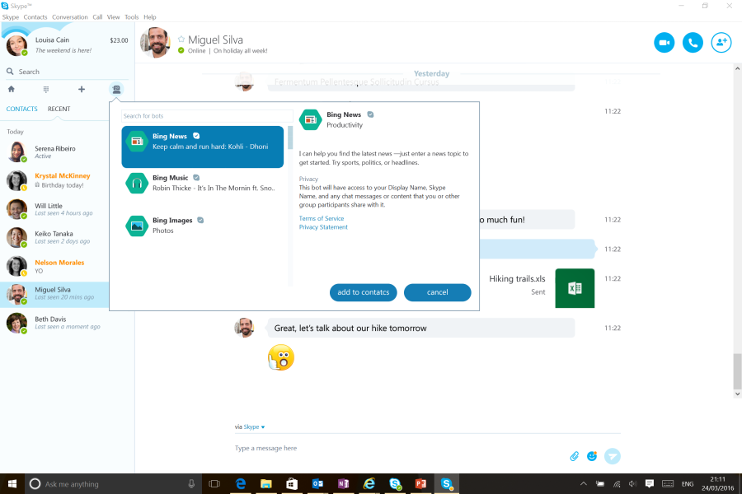
Microsoft Skype Bots
http://www.skype.com/developer
https://developer.microsoft.com/en-us/skype/bots
http://blogs.skype.com/2016/03/30/skype-bots-preview-comes-to-consumers-and-developers/
C# or Node.js

Slide 6
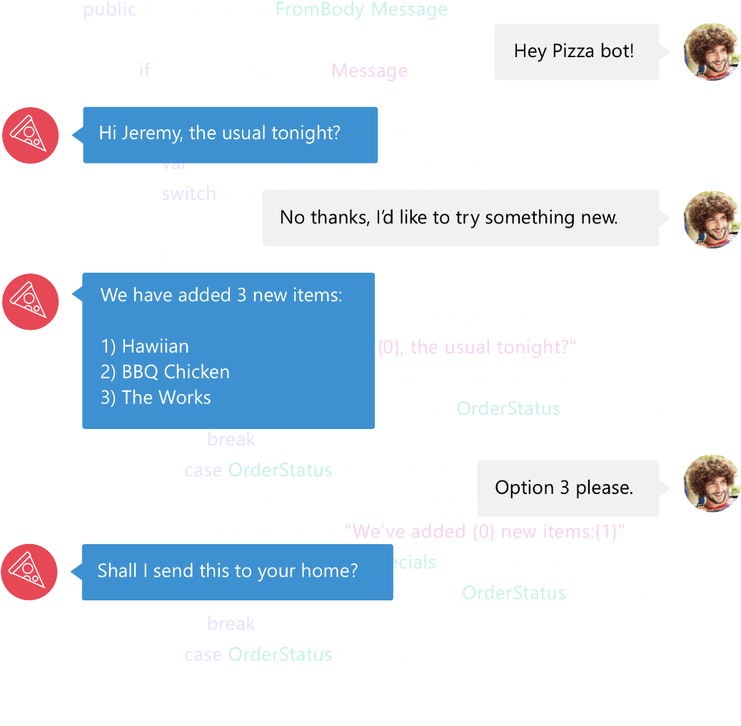

Bot Framework
Bot Framework is a Microsoft-operated service and an SDK.
Bot Framework is one of many tools Microsoft offers for building a complete bot.
Others include: LUIS, Speech APIs, Azure, more
www.botframework.com

Slide 7
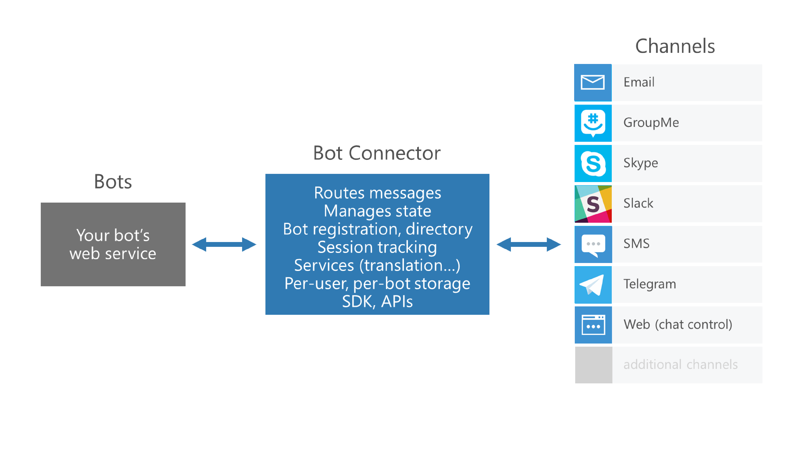
Microsoft Bot Framework

Slide 8
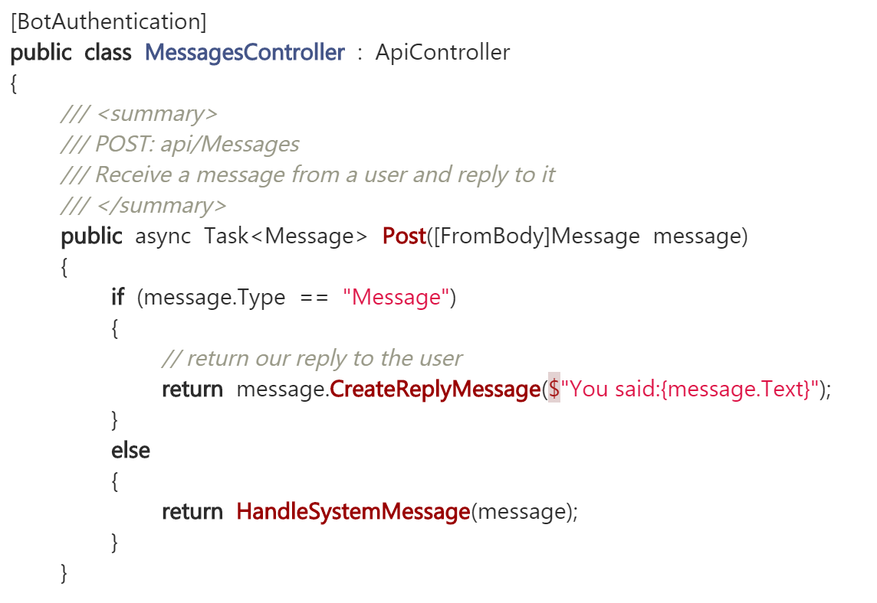
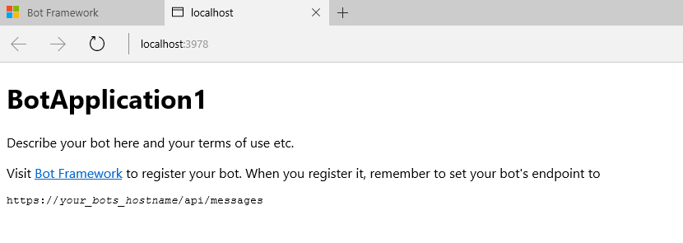
Microsoft Bot Framework
Download and install the Bot Application template
Building your Bot
Use the Bot Framework Emulator to test your Bot application

Slide 9
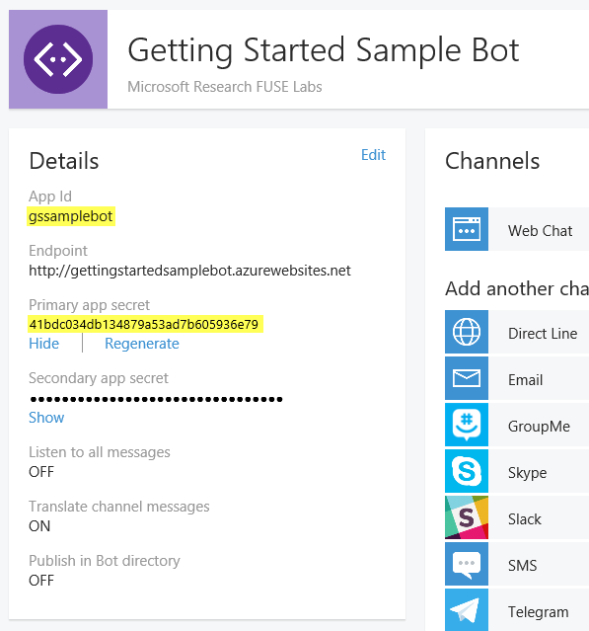
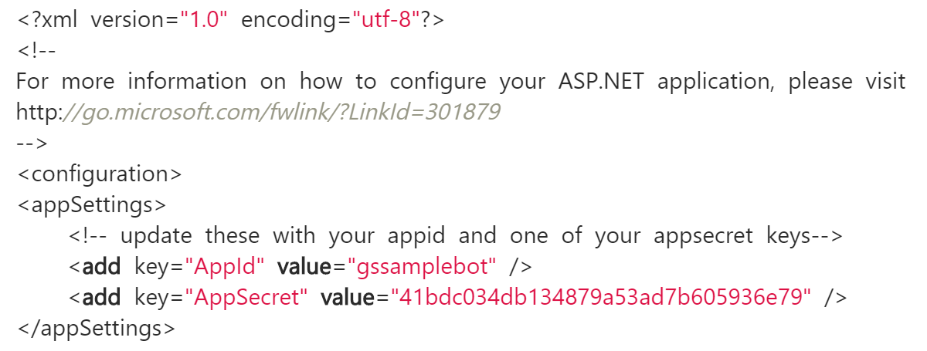
Microsoft Bot Framework
Registering and configuring your Bot with the Microsoft Bot Framework

Slide 10
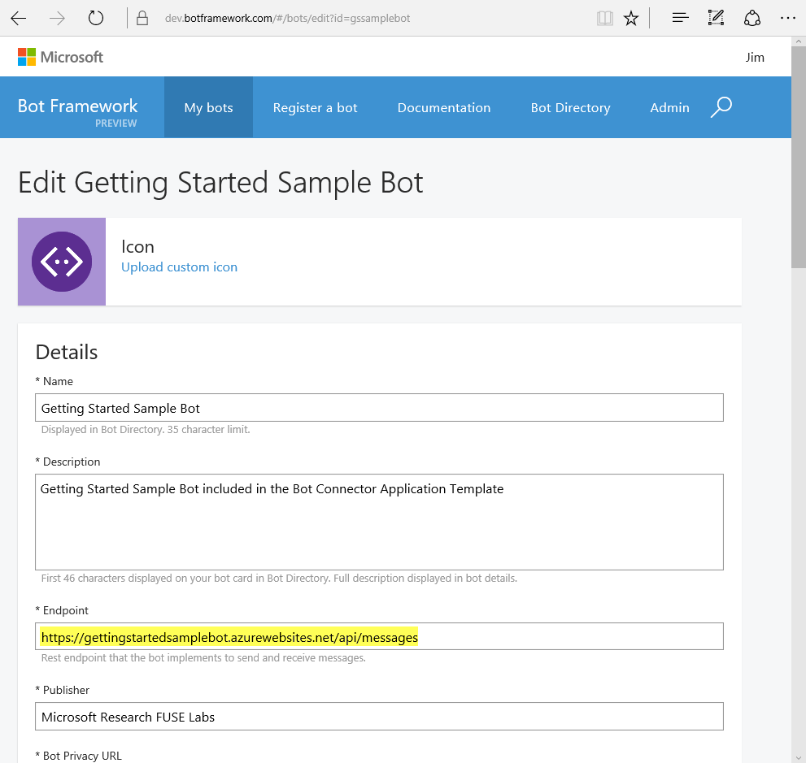
Microsoft Bot Framework
Configuring bot’s settings (including endpoint).

Slide 11
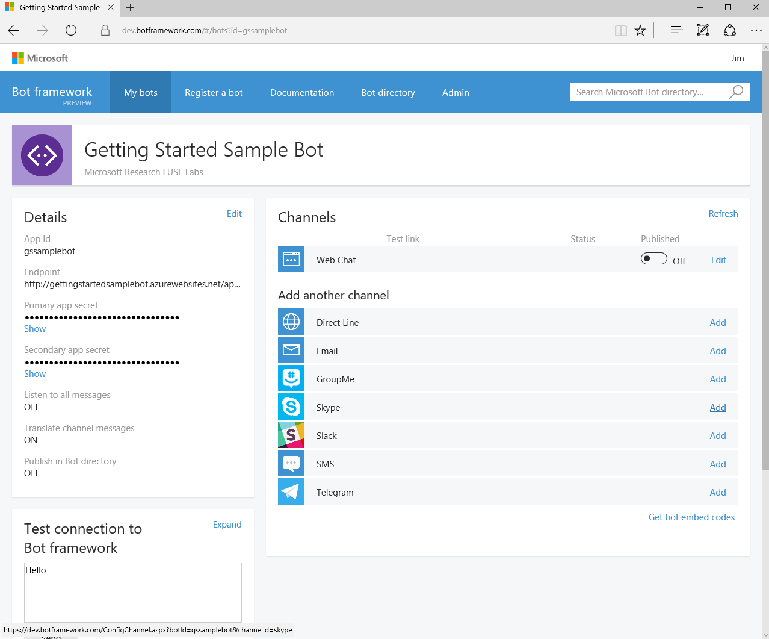
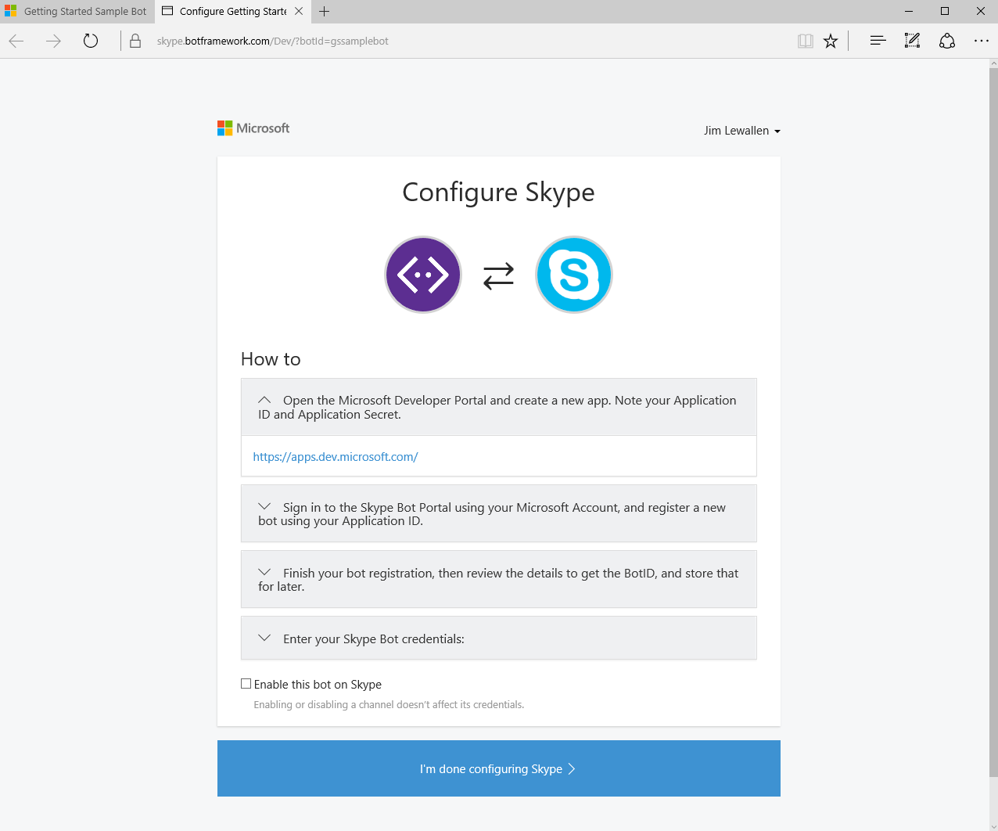
Microsoft Bot Framework
Configuring Channels

Slide 12
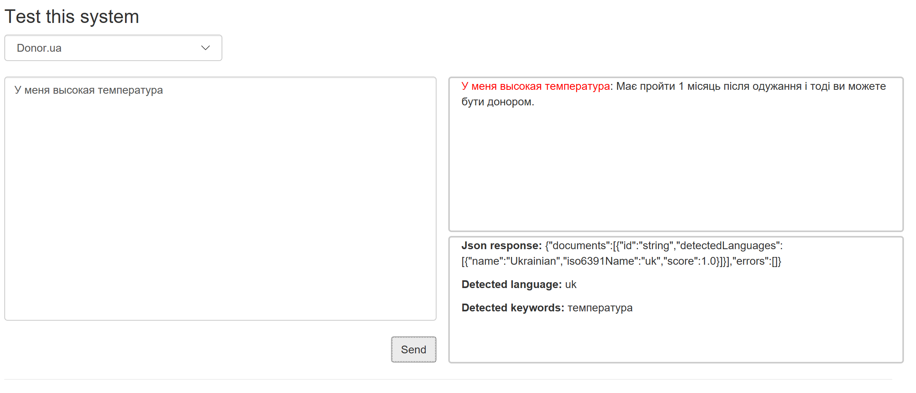
Q&A Endpoint
http://devrain-bots.azurewebsites.net/
https://qnamaker.ai

Slide 13
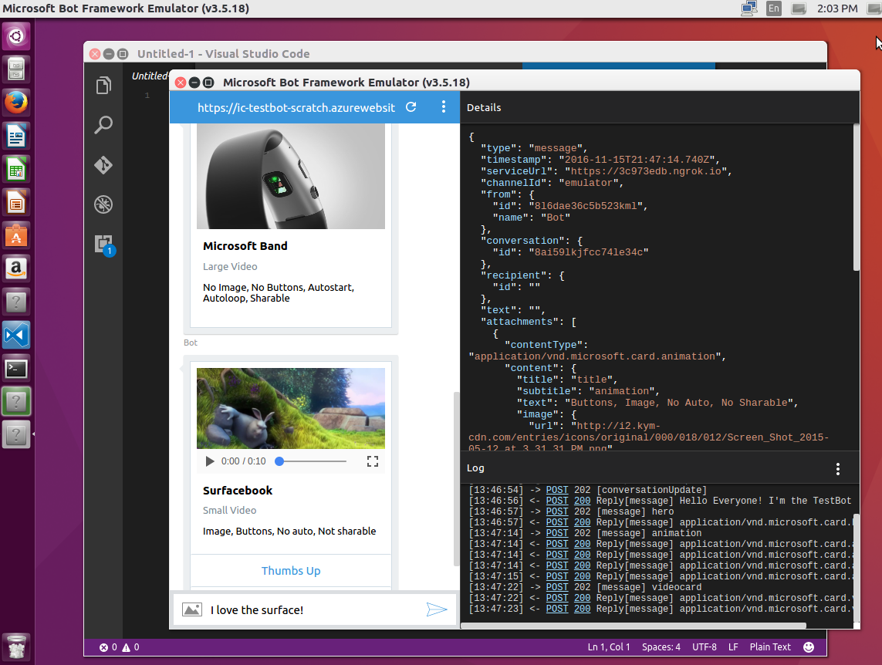
Microsoft Bot Framework Emulator
New Support for Mac, Linux and Windows
New All the Bot Framework card types are supported
New Save multiple profiles for when you’re working online and off
New Simplifies configuration when you’re working with ngrok
New Uses the webchat control for higher fidelity layout and consistency with the webchat experience
Send requests and receive responses to/from your bot endpoint on localhost
Inspect the Json response
Emulate a specific user and/or conversation
https://docs.botframework.com/en-us/tools/bot-framework-emulator/

Slide 14
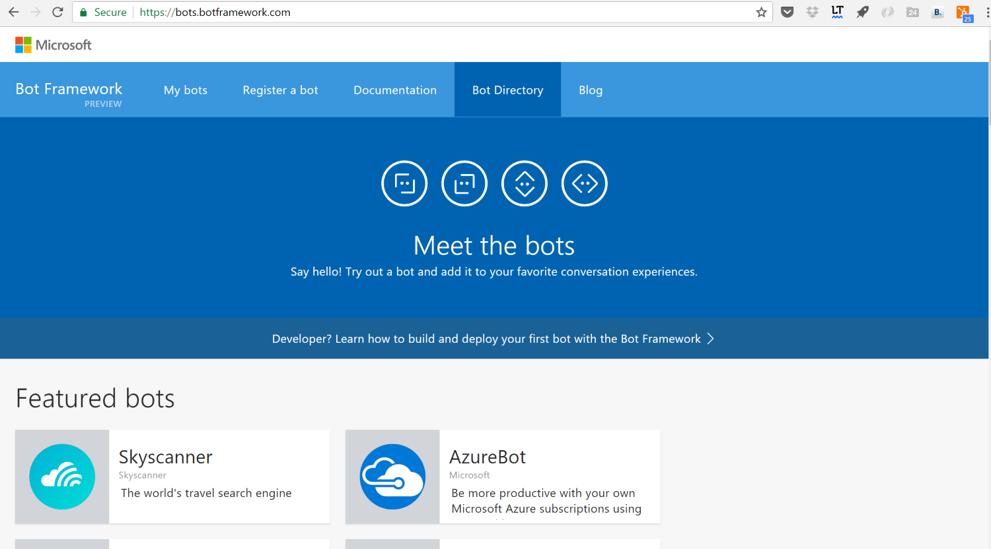
Bot Directory
https://bots.botframework.com/

Slide 15
NER/NLP
http://msg.ai/
OpenCalais https://www.opencalais.com/opencalais-demo/
Dbpedia Spotlight
AlchemyAPI
BitextAPI https://www.bitext.com/text-analysis-api/
CogitoAPI http://www.cogitoapi.com/
Entitizer (Romanian, Russian, Bulgarian, Hungarian) http://klangoo.com/search.aspx
Magnet by Klangoo (40+ languages, including Klingon ...) http://klangoo.com/search.aspx
MeaningCloud http://www.meaningcloud.com/
Ingen.io https://www.quora.com/topic/Ingen-io
Rosette (many European, Middle Eastern and Asian langauges) https://developer.rosette.com/
Saplo https://www.quora.com/topic/Saplo-company
Semantria https://www.quora.com/topic/Semantria
Aylien.com http://aylien.com/
TextRazor https://www.textrazor.com/
Wolfram Alpha https://www.wolframalpha.com/
Microsoft Cognitive Services & Azure ML https://www.microsoft.com/cognitive-services/en-us/apis

Slide 16
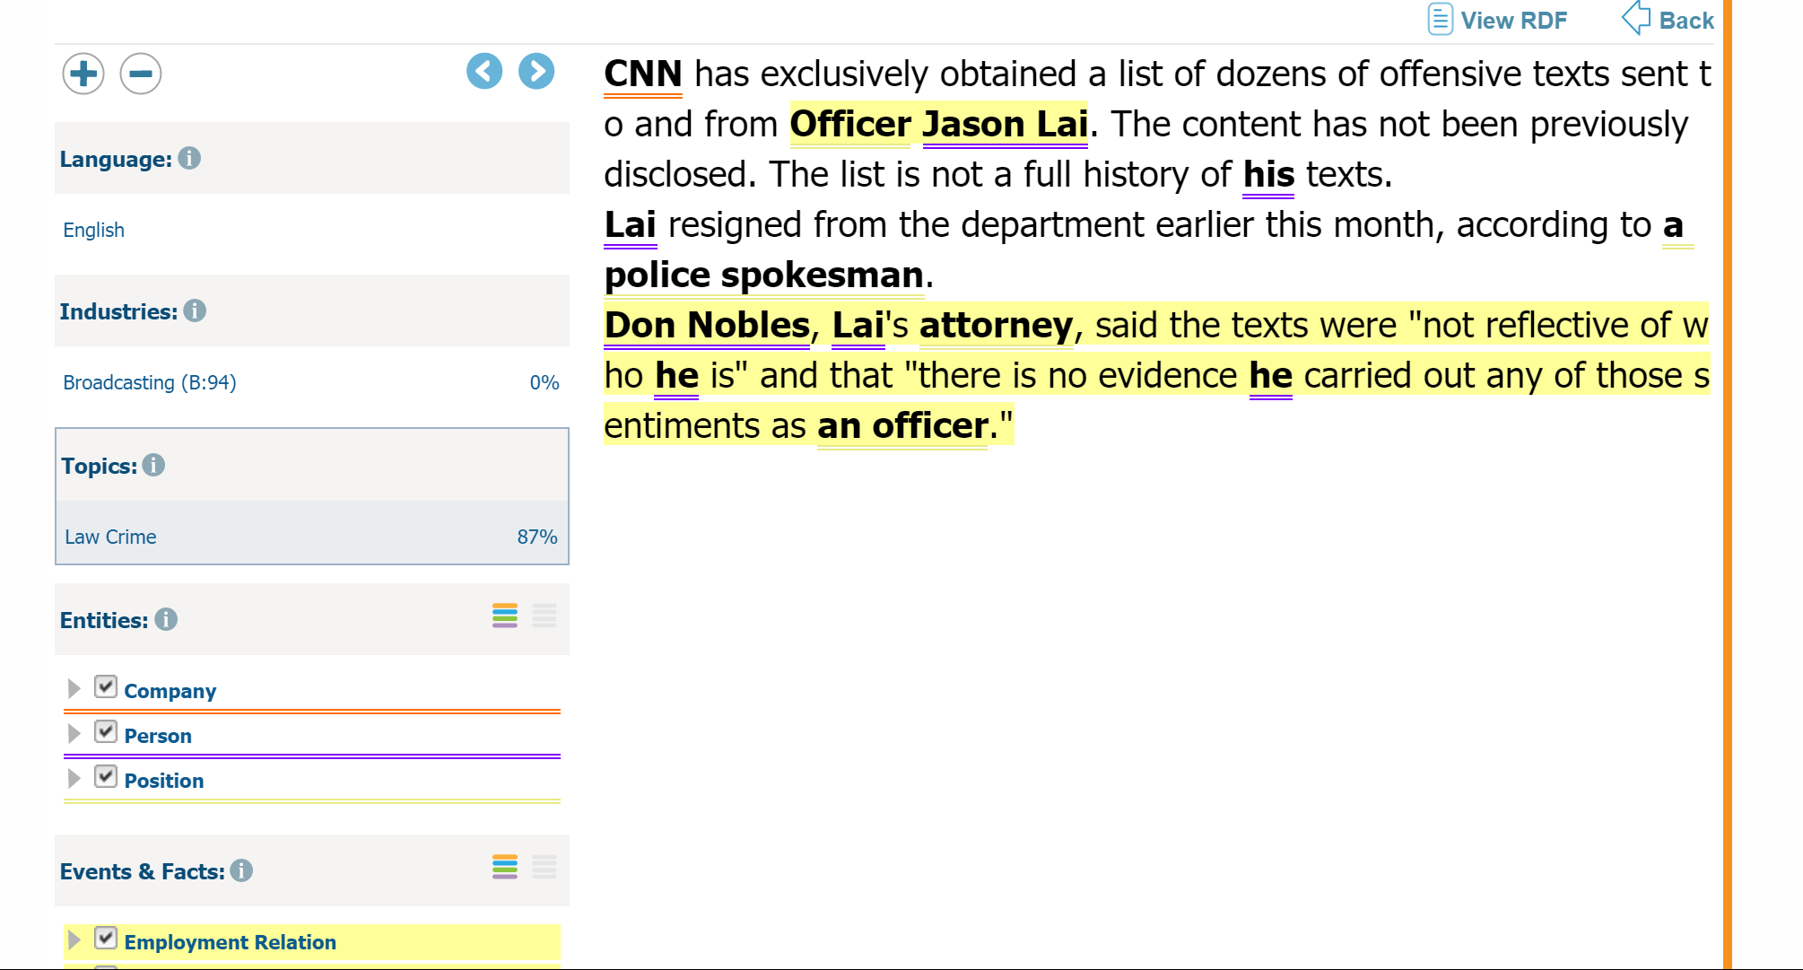
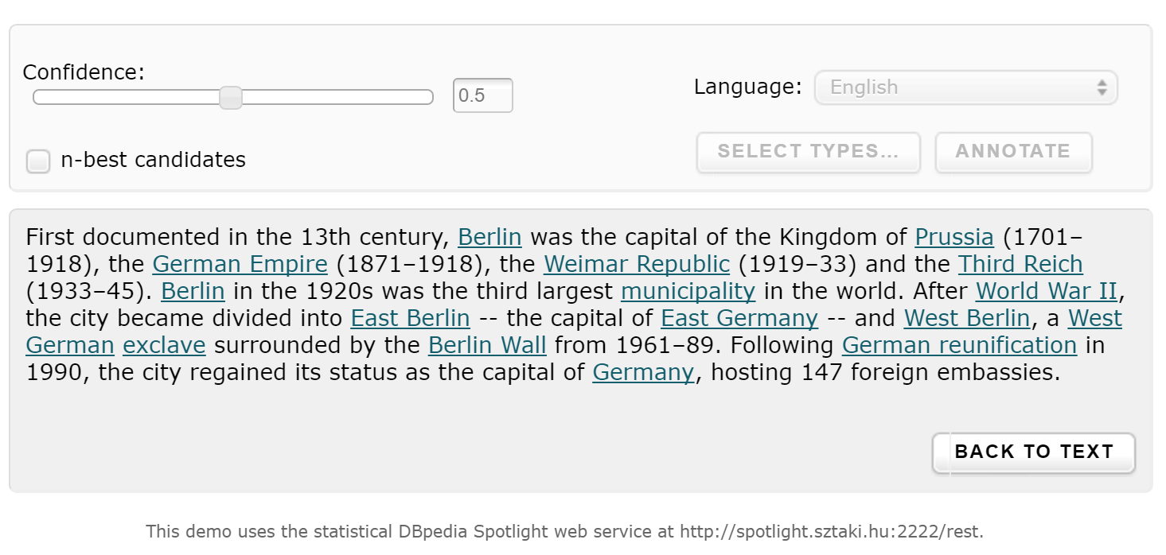
OpenCalais & Dbpedia

Slide 17
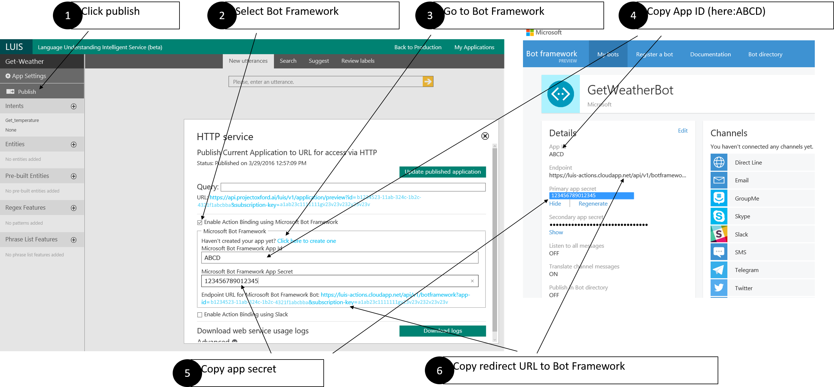
LUIS
Language Understanding Intelligent Service (beta)
Language Understanding Intelligent Service (beta) https://www.luis.ai

Slide 18
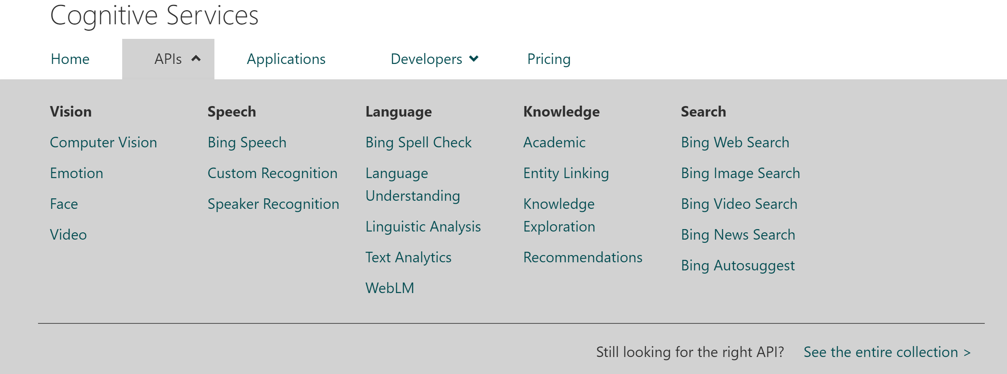
Microsoft Cognitive Services
Language Understanding Intelligent Service (beta)

Slide 19
Detecting language
Language Understanding Intelligent Service (beta)
var client = new HttpClient();
var queryString = HttpUtility.ParseQueryString(string.Empty);
// Request headers
client.DefaultRequestHeaders.Add("Ocp-Apim-Subscription-Key", “subscription_key");
// Request parameters
queryString["numberOfLanguagesToDetect"] = "1";
var uri = "https://westus.api.cognitive.microsoft.com/text/analytics/v2.0/languages?" + queryString;
HttpResponseMessage response;

Slide 20
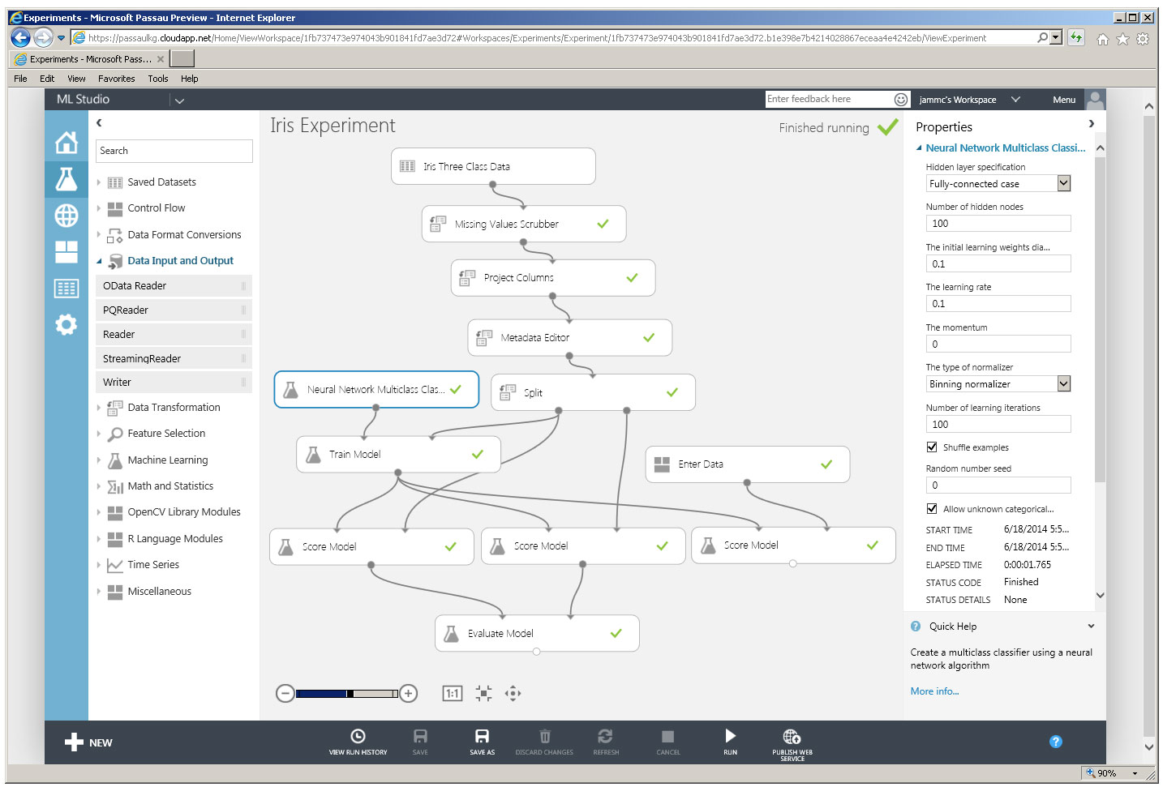
Azure Machine Learning (NER)
Language Understanding Intelligent Service (beta)
Microsoft Azure Machine Learning Studio is a collaborative, drag-and-drop tool you can use to build, test, and deploy predictive analytics solutions on your data.

Slide 21

Questions?
Oleksandr Krakovetskyi
CEO, DevRain Solutions
Microsoft MVP, Microsoft RD
alex.krakovetskiy@devrain.com
https://www.facebook.com/alex.krakovetskiy
@msugvnua

